Slide 1
Recovery Support Services for Adolescents in Recovery High Schools
Emily Hennessy, Beth Samuelson, and Bea Blackmon

Slide 2
Disclaimer: Funding for this initiative was made possible by grant no. 1H79TI083022 from SAMHSA. The views expressed in written conference materials or publications and by speakers and moderators do not necessarily reflect the official policies of the Department of Health and Human Services; nor does mention of trade names, commercial practices, or organizations imply endorsement by the U.S. Government.
Notes:
DISCLAIMER

Slide 3
If we want addiction destigmatized, we need a language that’s unified.
The words we use matter. Caution needs to be taken, especially when the disorders concerned are heavily stigmatized as substance use disorders are.
https://www.recoveryanswers.org/addiction-ary/

Slide 4
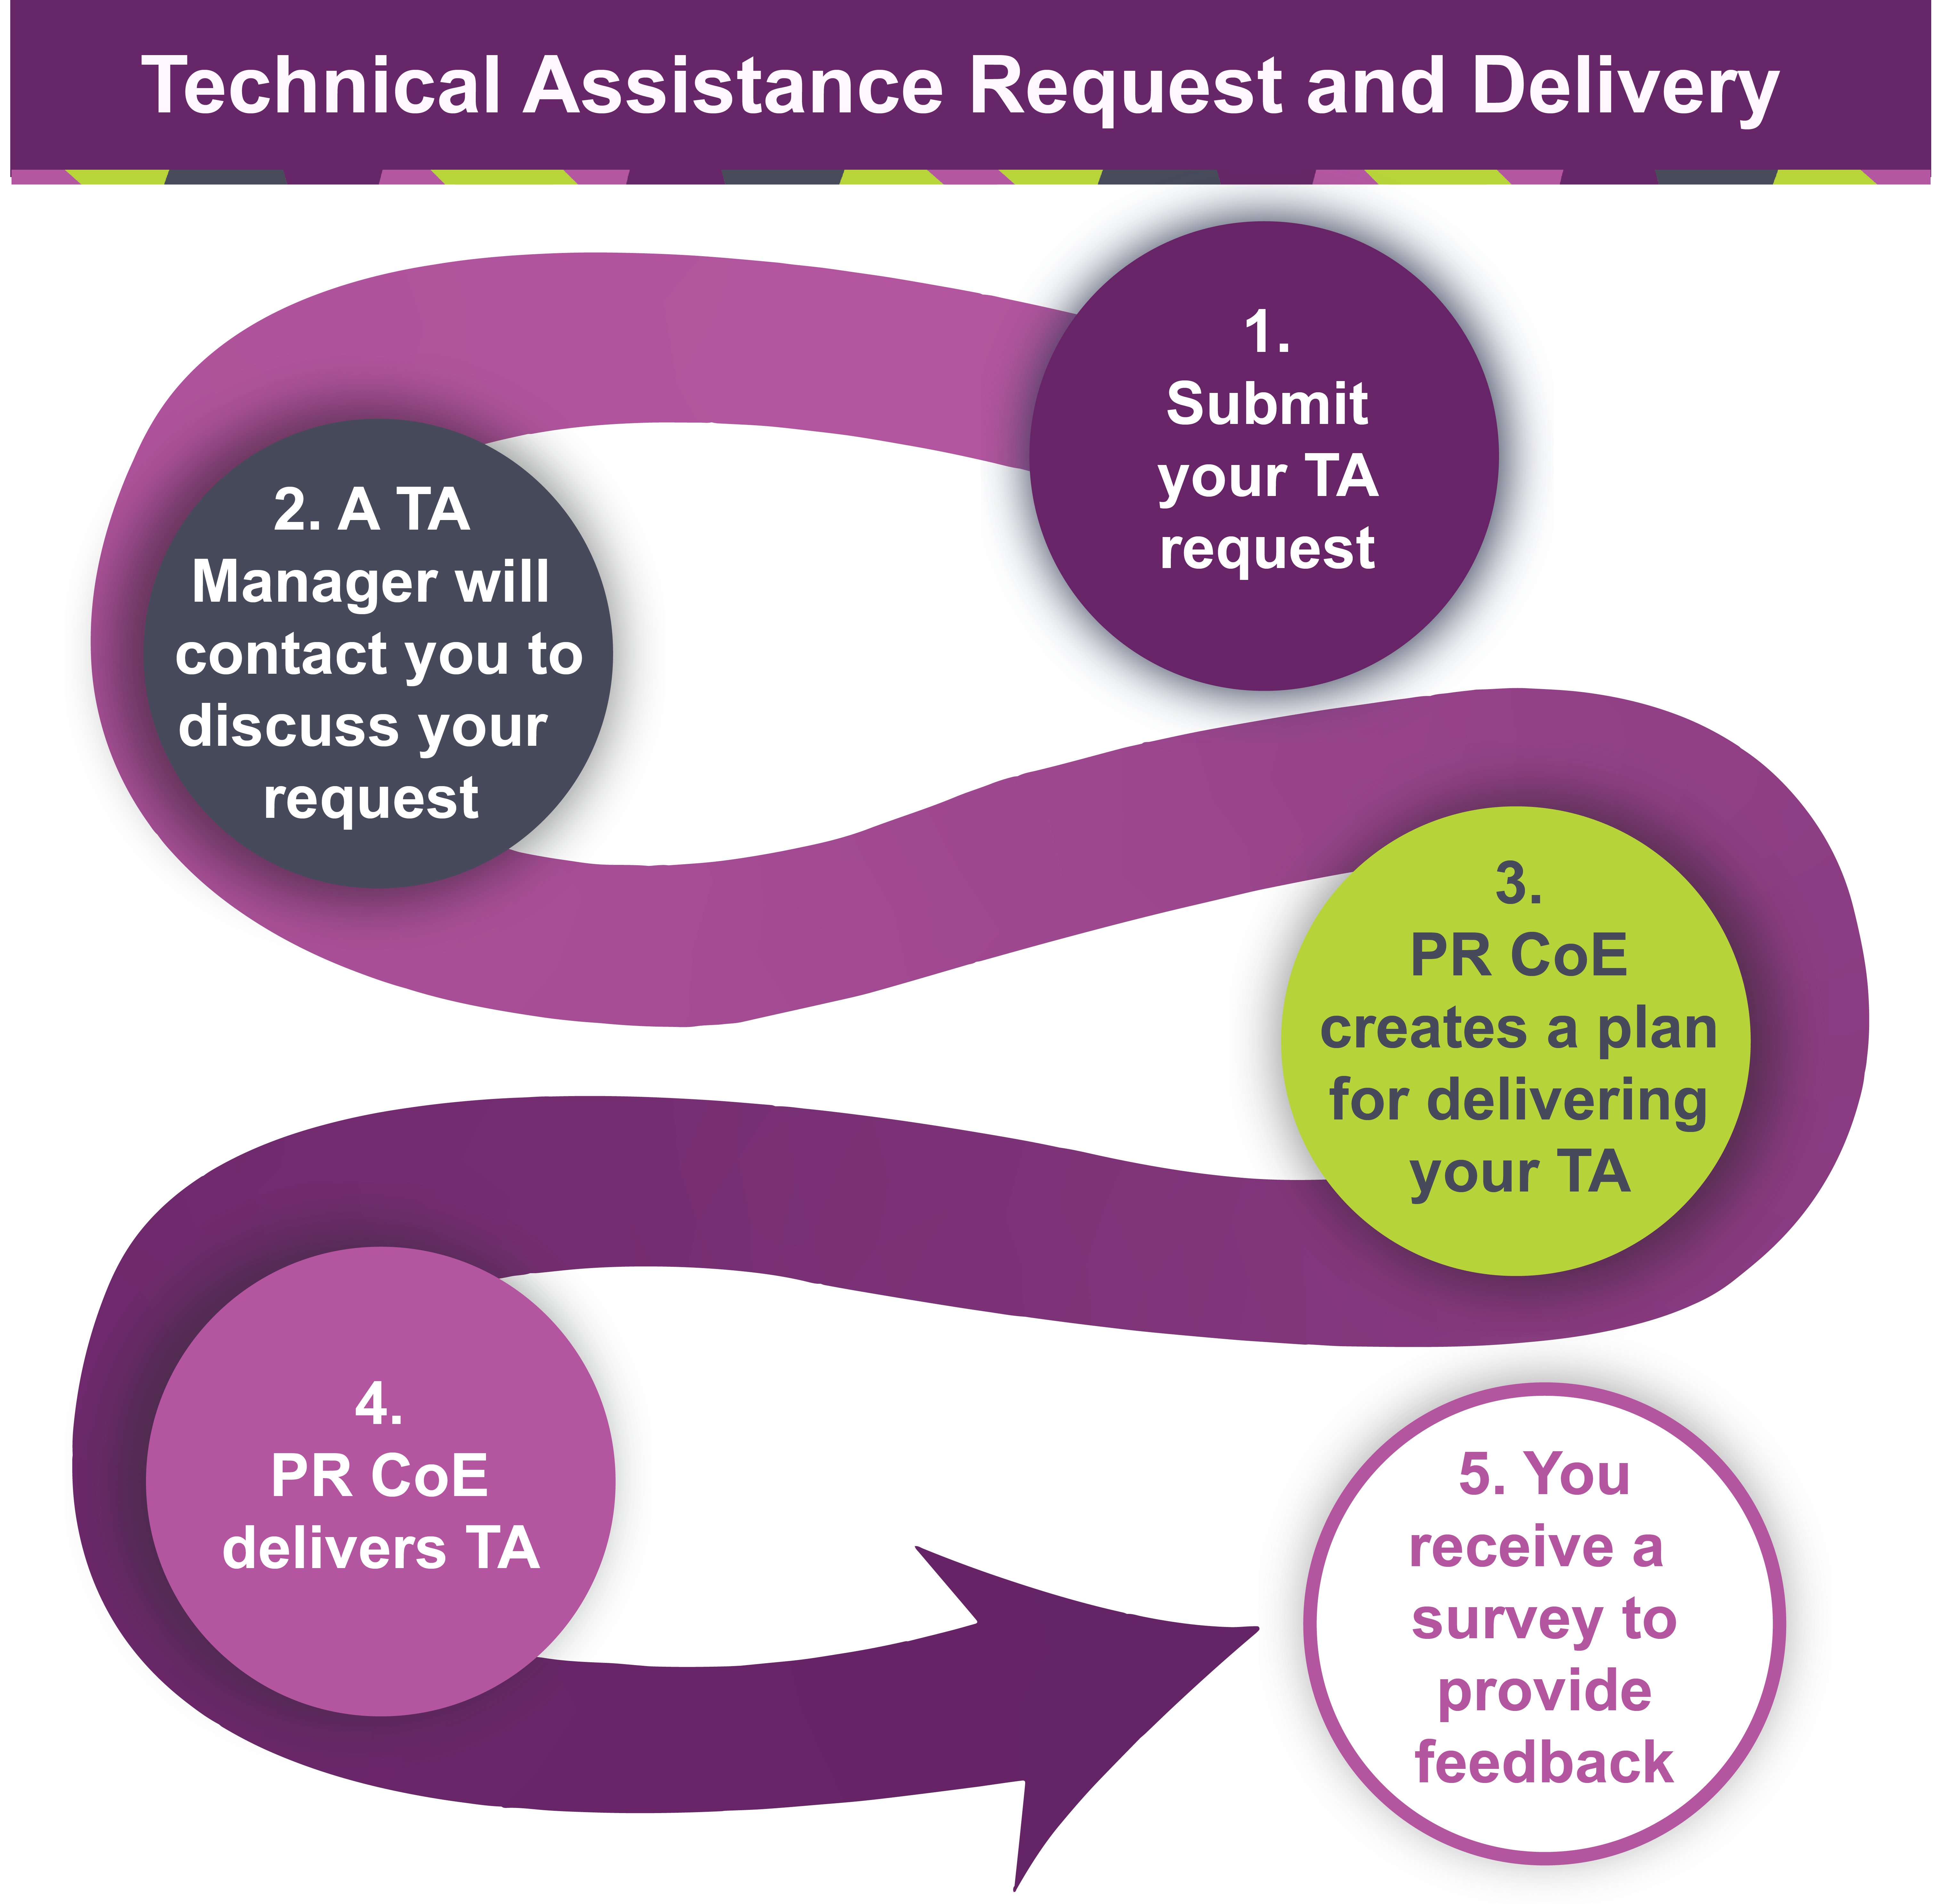

Slide 5
Association of Recovery Schools
ARS, founded in 2002, is the member organization and accrediting body for approximately 50 recovery high schools across the United States.
The primary purpose of a RHS is to educate and support students in recovery from substance use or co-occurring disorders.
RHSs must meet the following the criteria:
State requirements are met for awarding a secondary school diploma
All students are working a recovery program for substance use or co-occurring disorders
All students are working towards an abstinence-focused recovery program
RHSs provide support for families learning how to live with, and provide support for, their teens in recovery.

Slide 6
Housekeeping Notes
This presentation will be recorded.
Please mute yourselves when the presenter is speaking.
When you speak, please identify yourself by name and work area to help others recognize you.
During the presentation, submit questions and feedback in the chat box.
[Q/A session will follow the presentation]
You will receive the slides for this presentation via email.
We value your feedback! If an evaluation link is provided at the end of the presentation, please submit your response within 1-2 days.

Slide 7
Supporting adolescents in a Recovery High School setting involves addressing their unique needs related to substance use recovery while also providing a supportive educational environment.
In this presentation, we will
discuss the creation and evolution of recovery support services for adolescents within an academic setting, most notably the importance of a strong culture of peer-to-peer supports.
explore the evidence-based research behind the peer-to-peer support model in adolescent recovery settings.
present a model of peer-to-peer recovery supports at Rise Academy in San Antonio, TX

Slide 8
Factors that Impact and Support Recovering Youth

Slide 9
Evidence on recovery social influences
 | SUPPORT | BARRIER
PEERS | Youth with more social support and friends actively supporting recovery efforts → more likely to be abstinent | Use among peers is strong predictor of relapse
FAMILIES | Structure, i.e., use of “cutoffs” or issuing ultimatums around substance use; Engage in family system treatment; Learning new parenting practices and skills | Noticeable substance use; Strained relationships; Poor communication
RECOVERY ROLE MODELS | Model recovery behaviors; Understand the nature of addiction; Support the youth in their recovery process; Connection to larger recovery community | Lack of access in some communities; negative stigma around recovery culture
Brown et al. 2001; Chi et al. 2009; Ramo and Brown 2008; Ramo et al. 2012; Brown et al. 1994; Elswick et al. 2018; Heller and Russell 2015; Henderson et al. 2009; Hennessy et al., under review; Liddle et al. 2009; Nash et al., 2019; Stanger et al. 2015; Tanner-Smith et al. 2013; Nash et al., 2015

Slide 10
Social Identity Theory
Divide social world into categories
You either belong to a group or you see another group as “other”
People seek a positive social identity
A positive social identity can serve basic developmental needs, certainty, self-esteem, and meaning
I am who I am – we are who we are
Scheepers & Ellemers, 2019

Slide 11
Experiment with different social identities

Slide 12
RECOVERY CAPITAL
+++
---
BARRIERS TO RECOVERY
SOCIAL NETWORK CHANGE THROUGHOUT RECOVERY
Kay & Monaghan, 2019; Best et al., 2016

Slide 13
Pilot Study with 28 “Recovering” Youth Participants
20 male; 7 female; 1 non-binary: 14-19 years (M=17.32, SD=1.23)
18 Non-Hispanic, White (64%)
20 recruited from recovery high schools*
3 focus groups; 22 individual maps
Primarily virtual, video-recorded (Zoom)
Jurinsky, J., Cowie, K., Blyth, S., & Hennessy, E. A. (2023). “A lot better than it used to be”: a qualitative study of adolescents’ dynamic social recovery capital. Addiction Research & Theory, 31(2), 77-83.
Blyth, S. H., Cowie, K., Jurinsky, J., & Hennessy, E. A. (2023). A qualitative examination of social identity and stigma among adolescents recovering from alcohol or drug use. Addictive Behaviors Reports, 18, 100505.

Slide 14
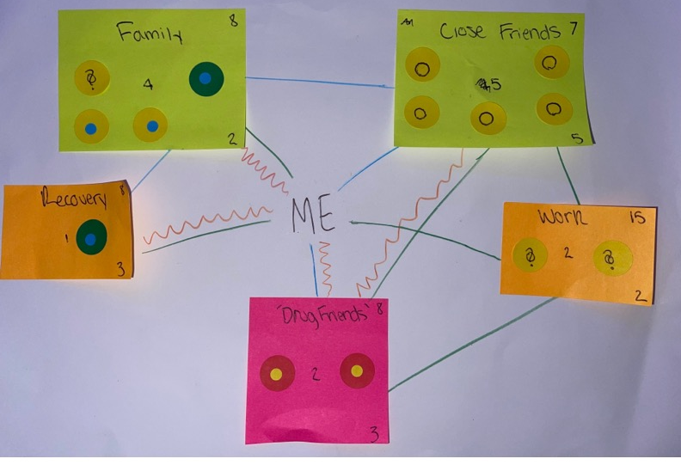
Study Activities
Facilitated Social Identity Map
Brief demographic survey
Interview to reflect on completed SIM and the process of completing it
Beckwith et al., 2018; Best et al., 2018; Cruwys et al., 2016; Haslam et al., 2017

Slide 15
Relationship between days spent with groups and group drug use status
*No differences by alcohol use status

Slide 16
In their words…
"And I guess I just feel safe, more safe, even like if they’re, like, I have a few friends who are still actively using, and I have a few friends who’ve passed away and I just, like, relate to it. Like, um, I guess I really started relating to drug addicts more was when I started talking about it, because, like, my girlfriend passed away, she OD’d nine months ago, and, like, I started talking about it, and, like, it was only drug addicts who really understood, like, Oh my god, like, she had a problem. And like other people I explain it to sometimes and they’ll be like oh that’s her fault, like, she’s the one that did it." (Male, 19 yrs)
"So like it’s really hard for like kids my age to like get sober and no one else is sober or even tried to get sober. So it’s really nice to have that aspect of like relatability, and also the accountability that you get...But not just by the staff, but like peer accountability." (Male, 18 yrs)
"And obviously the church friends and the recovery school, that’s obvious, but, like, everywhere else, it’s like there’s such easy access to me continuing to use…” (Female, 17 yrs.)
“I’m graduating in May -- or no, early June. So, I want to keep the people in my recovery high school in my life. The people that I have on there are teachers or the principal. And they have been very instrumental to my recovery, to my success. And I would want to keep them in my life. So even when I’m not seeing them every day, I’d want them to stay that way.” (Female, 18 yrs)

Slide 17
Need for Recovery Support Services for Adolescents in Secondary School Settings and the Creation of Recovery High Schools

Slide 18
Importance of recovery supports for adolescents:
Asking an adolescent who just returned from treatment to go back to their high school is like asking a newly sober adult to go to a “bar” 8 hours a day.
In the absence of recovery supports, research suggests that 6 = 8 out of 10 teens will experience a recurrence within 6 months.

Slide 19
Why recovery schools are important:
Compared to students in non-recovery high schools who have received treatment, students in recovery schools:
Have a higher graduation rates
Report lower absenteeism
Are more likely to abstain from using substances
Have fewer days using THC and other drugs
Source: Finch, Tanner-Smith, Hennessy and Moberg 2018 and Weimer et al 2019

Slide 20
Licensed Professional Support
Peer Recovery Support Specialist
LADC’s
Social Worker’s
School Counselor’s
LPC’s
Mental Health Peer Support

Slide 21
Peer Support at Insight Recovery School
Daily groups
Individualized meeting with student and LADC
Phase system
Peers supporting each other
Leadership group

Slide 22
Building a Peer-to-Peer Recovery Support System

Slide 23
Strategies for creating a robust peer-to-peer recovery support network within a school.
Eclectic Staff Peer Recovery Support Specialists
Holistic Approach
Personalized Support
Strengths-Based Perspective
Non-Judgmental Attitude
Flexibility and Creativity
Notes:
In order to create a “True Peer t Peer Recovery Support Model. Our students must begin with someone to Model after.
1. Selection of Recovery Support Peer Specialists.

Slide 24
Empowering current students to serve as peer mentors
Peer Mentorship Program Structure
Program Goals and Objectives
Recruitment and Selection
Role Modeling
Empowerment and Autonomy
Recognition and Rewards

Slide 25
Cultivating a future workforce in the field of peer recovery
Education and Training Programs
Recovery-Focused Curriculum
Restorative Practices
Diverse Perspectives
Community Engagement
Advocacy and Awareness

Slide 26
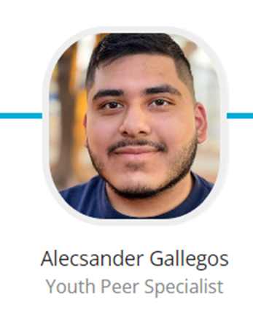
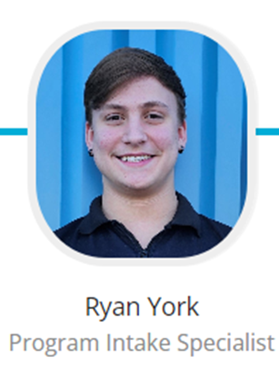
Graduates Next Steps…..
Training Institute
Internship and Apprenticeship
Certification and Credentialing

Slide 28
Connect with us!
@PeerRecoveryCoE
www.PeerRecoveryNow.org
@peer_recovery
Peer Recovery Now
Notes:
Insert link in the chat box: “Visit our website to learn more about the Peer Recovery Center of Excellence: www.PeerRecoveryNow.org”

