Slide 1
Research Presentation:
Moving Towards Racially Just, Restorative School Cultures
2/27/2024

Slide 2
Effects of Exclusionary Discipline
Studies show that suspensions do not make schools safer but they:
Increase alienation and disengagement
Undermine overall school climate
Reduce academic progress
Increase dropout rates

Slide 3
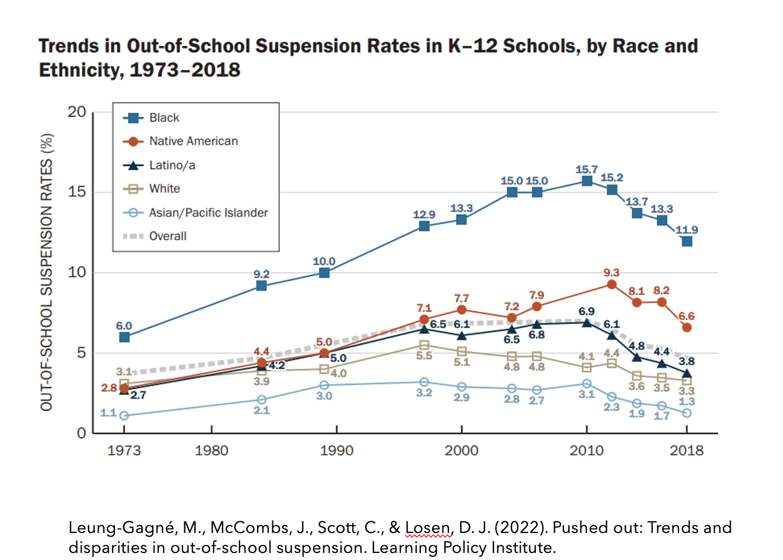
School Exclusions are Racially Disparate

Slide 4
Defining Restorative Practices
Restorative approaches “proactively build healthy relationships and a sense of community to prevent and address conflict and wrongdoing.” (Schott Foundation)
Restorative practices are designed to:
Building a sense of community in schools
Teach interpersonal/ communication skills
Proactively meet student needs
Repair harm when conflict occurs

Slide 5
Range of Restorative Practices
Tier III
individual
students
Re-entry and re-integration
Intervention circles
Re-entry circles
Non-punitive responses to disruptive behavior
Conflict mediation
Healing of problem-solving circles
Repair conversations
Tier II
small groups of students
Building relationships, trust, and community
Classroom, advisory, and schoolwide circles
Community agreements
Affective statements
Tier I
all settings and all students

Slide 6
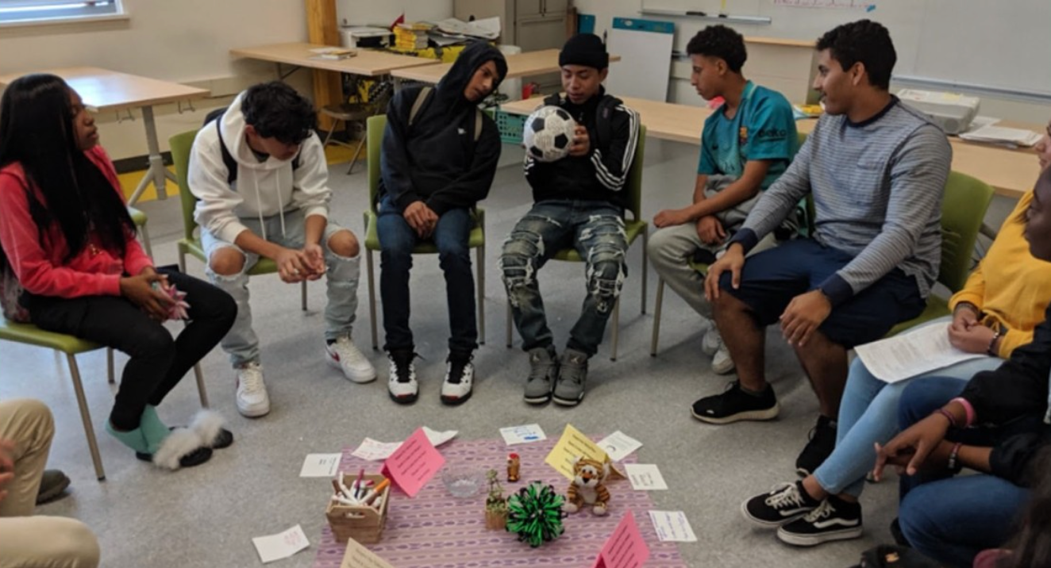
Restorative Circles
Restorative circles can be used for many purposes including community helping, to help students connect with academic content, and to repair harm after an incident
Questions asked during restorative circles used to repair harm:
What happened?
What were you thinking when this happened?
Who was affected by what happened?
What needs to happen to make this situation right?
Students at Fremont High School participate in a restorative circle.

Slide 7
Impact of Restorative Practices
A growing body of research indicates that well-implemented restorative restorative practices:
Improve student behavior
Decrease fighting and bullying
Reduce office referrals and classroom removals
Reduce suspensions and expulsions
Decrease disciplinary disparities
Improve school climate (e.g. relationships between teachers and students, student feelings of connectedness to school)

Slide 8
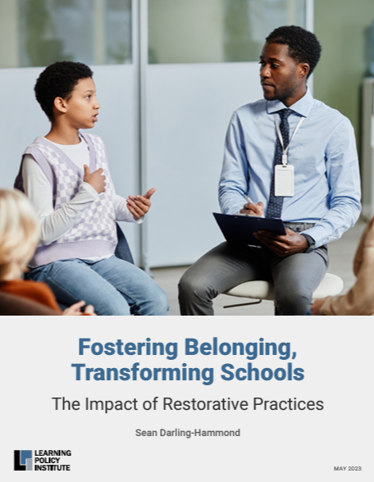
Impact of Restorative Approaches
A recent study of a large-scale data set in California found that as schools became more restorative, they saw the following benefits:
Reduced :
Misbehavior
Gang membership
Victimization
Depressive symptoms
Sleep deprivation
Illness
Substance abuse
Absences
Improved:
GPA
School Climate

Slide 9
Resources

